Slide 1
SIMPLE CALCULATOR (USING PYTHON)
PRESENTED BY,
SHATAKSHI DUDALA

Slide 2
Introduction
A calculator is a basic computational tool that performs arithmetic operations.
Our focus is to design a simple yet effective calculator using Python.
This project introduces Python basics like functions, conditionals, and loops.

Slide 3
Objectives
Create a calculator that can:
Add, Subtract, Multiply, Divide.
Handle invalid inputs gracefully.
Provide a user-friendly interface in the terminal.

Slide 4
Features of Our Calculator
User-defined functions for operations
Input validation
Menu-driven interface
Looping until user decides to exit

Slide 5
Python Code:
import tkinter
from tkinter import *
root=Tk()
root.title("Simple calculator")
root.geometry("570x600+100+200")
root.resizable(False,False)
root.configure(bg="#17161b")
equation=""
def show(value):
global equation
equation+=value
label_result.config(text=equation)

Slide 6
def clear():
equation=""
label_result.config(text=equation)
def clear():
global equation
equation = ""
label_result.config(text=equation)
def calculate():
global equation
result =""
if equation !="":
try:
result=eval(equation)

Slide 7
except:
result ="error"
equation =""
label_result.config(text=result)
label_result=Label(root,width=25,height=2,text="",font=("arial",30))
label_result.pack()
Button(root,text="C",width=5,height=1,font=("arial",30,"bold"),bd=1,fg="#fff",bg="#3697f5",command=lambda: clear()).place(x=10,y=100)
Button(root,text="/",width=5,height=1,font=("arial",30,"bold"),bd=1,fg="#fff",bg="#2a2d36",command=lambda: show("/")).place(x=150,y=100)
Button(root,text="%",width=5,height=1,font=("arial",30,"bold"),bd=1,fg="#fff",bg="#2a2d36",command=lambda: show("%")).place(x=290,y=100)
Button(root,text="*",width=5,height=1,font=("arial",30,"bold"),bd=1,fg="#fff",bg="#2a2d36",command=lambda: show("*")).place(x=430,y=100)

Slide 8
Button(root,text="7",width=5,height=1,font=("arial",30,"bold"),bd=1,fg="#fff",bg="#2a2d36",command=lambda: show("7")).place(x=10,y=200)
Button(root,text="8",width=5,height=1,font=("arial",30,"bold"),bd=1,fg="#fff",bg="#2a2d36",command=lambda: show("8")).place(x=150,y=200)
Button(root,text="9",width=5,height=1,font=("arial",30,"bold"),bd=1,fg="#fff",bg="#2a2d36",command=lambda: show("9")).place(x=290,y=200)
Button(root,text="-",width=5,height=1,font=("arial",30,"bold"),bd=1,fg="#fff",bg="#2a2d36",command=lambda: show("-")).place(x=430,y=200)
Button(root,text="4",width=5,height=1,font=("arial",30,"bold"),bd=1,fg="#fff",bg="#2a2d36",command=lambda: show("4")).place(x=10,y=300)
Button(root,text="5",width=5,height=1,font=("arial",30,"bold"),bd=1,fg="#fff",bg="#2a2d36",command=lambda: show("5")).place(x=150,y=300)
Button(root,text="6",width=5,height=1,font=("arial",30,"bold"),bd=1,fg="#fff",bg="#2a2d36",command=lambda: show("6")).place(x=290,y=300)
Button(root,text="+",width=5,height=1,font=("arial",30,"bold"),bd=1,fg="#fff",bg="#2a2d36",command=lambda: show("+")).place(x=430,y=300)

Slide 9
Button(root,text="1",width=5,height=1,font=("arial",30,"bold"),bd=1,fg="#fff",bg="#2a2d36",command=lambda: show("1")).place(x=10,y=400)
Button(root,text="2",width=5,height=1,font=("arial",30,"bold"),bd=1,fg="#fff",bg="#2a2d36",command=lambda: show("2")).place(x=150,y=400)
Button(root,text="3",width=5,height=1,font=("arial",30,"bold"),bd=1,fg="#fff",bg="#2a2d36",command=lambda: show("3")).place(x=290,y=400)
Button(root,text="0",width=11,height=1,font=("arial",30,"bold"),bd=1,fg="#fff",bg="#2a2d36",command=lambda: show("0")).place(x=10,y=500)
Button(root,text=".",width=5,height=1,font=("arial",30,"bold"),bd=1,fg="#fff",bg="#2a2d36",command=lambda: show(".")).place(x=290,y=500)
Button(root,text="=",width=5,height=3,font=("arial",30,"bold"),bd=1,fg="#fff",bg="#fe9037",command=lambda: calculate()).place(x=430,y=400)
root.mainloop()

Slide 10
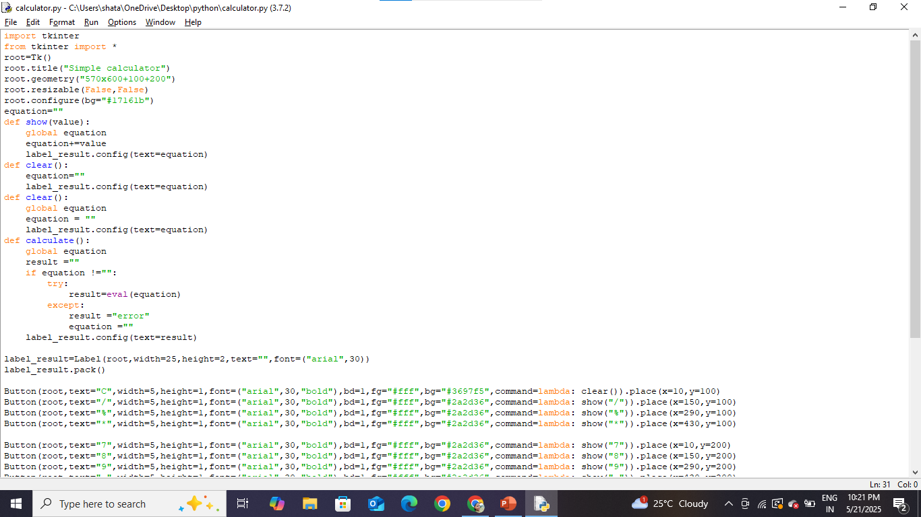

Slide 11
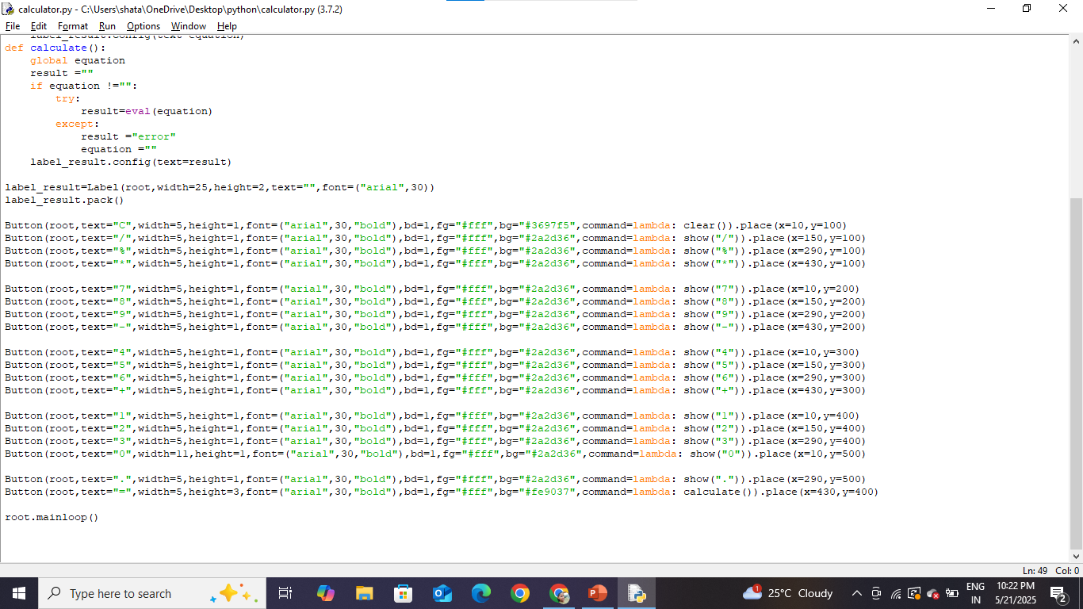

Slide 12
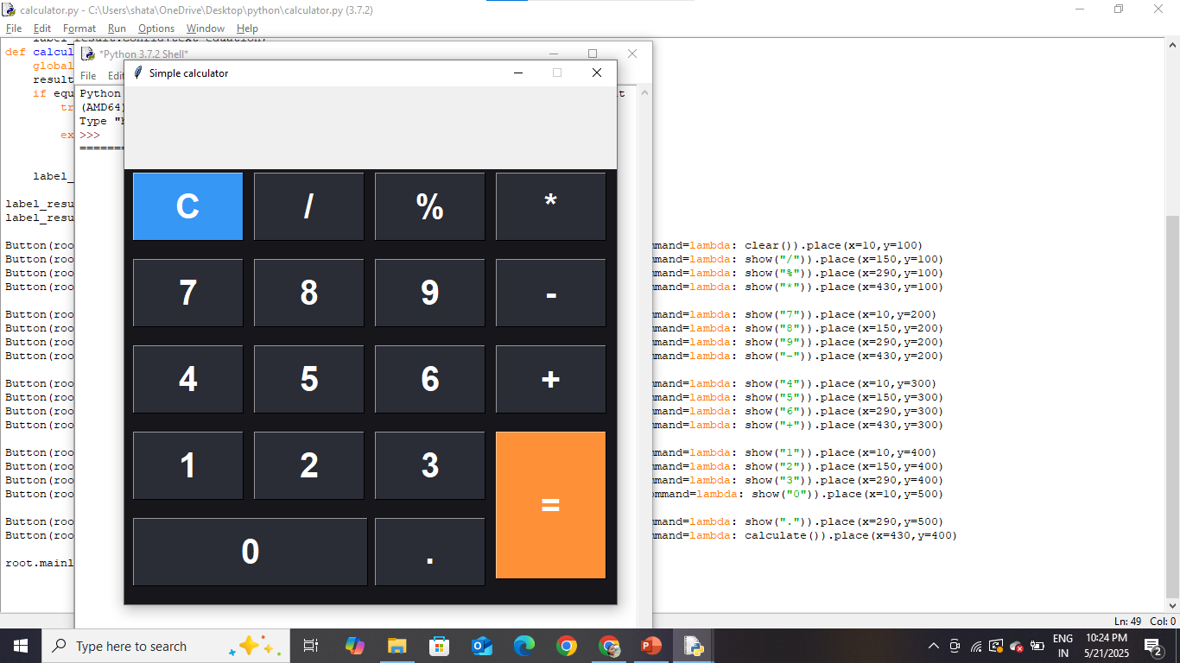
OUTPUT

Slide 13



Slide 14
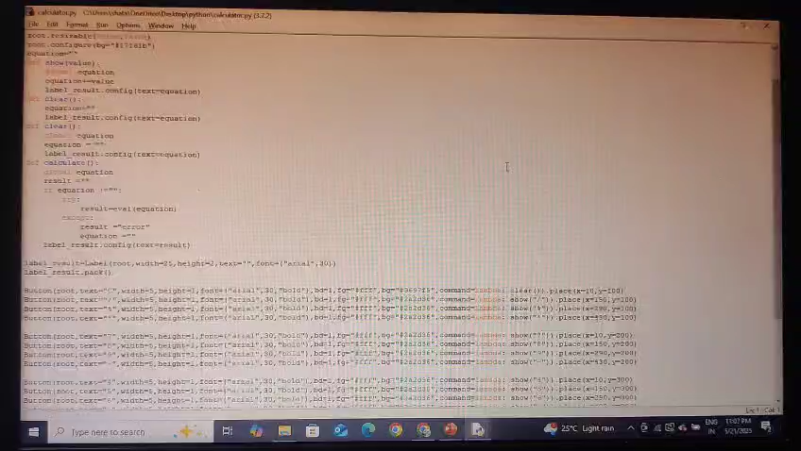

Slide 15


